Slide 1
Black hole!!! கருந்துளை
Dr.C. Joseph Prabagar, TASS EC member Lecturer in Physics
Central Polytechnic College
Chennai -113
27-11-2024

Slide 2
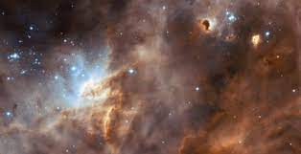
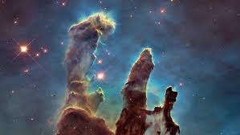
How star forms?
…….Clouds of gas and dust (largely of Hydrogen)

Slide 3
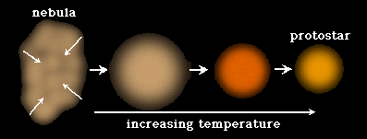
How do star forms?
Temperature increases…
Internal pressure build up….
Proto star formed….

Slide 4
Nuclear Fusion starts….
Star is born
Main sequence star…
Sun is a main sequence star…

Slide 5
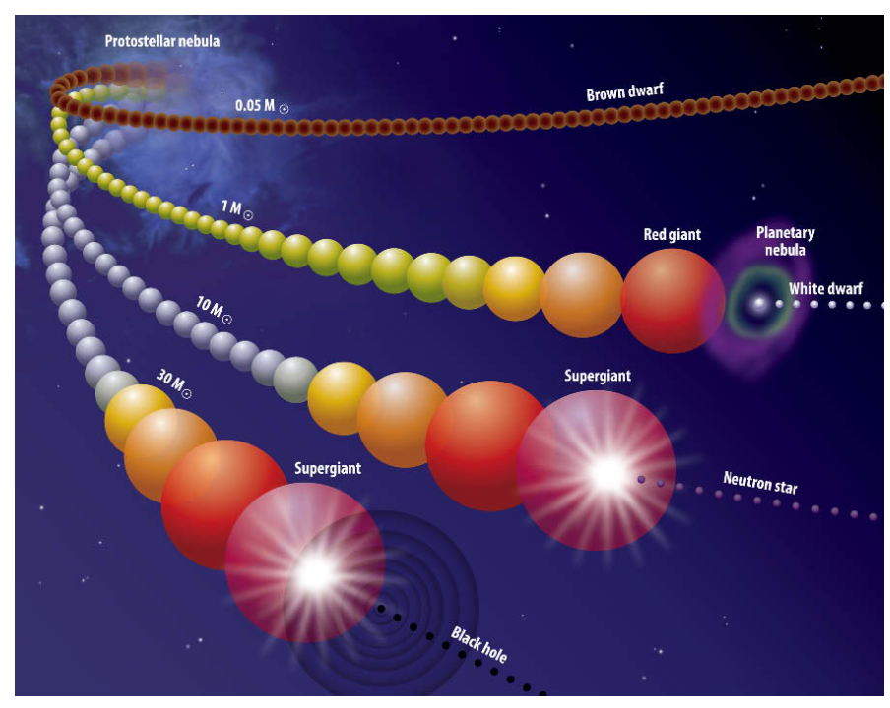

Slide 6
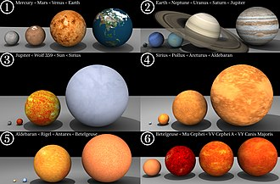
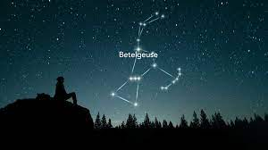
Red giant ---- Nova
Super red gaint ----- Supernova (Bettelgeuse, Antares)

Slide 7
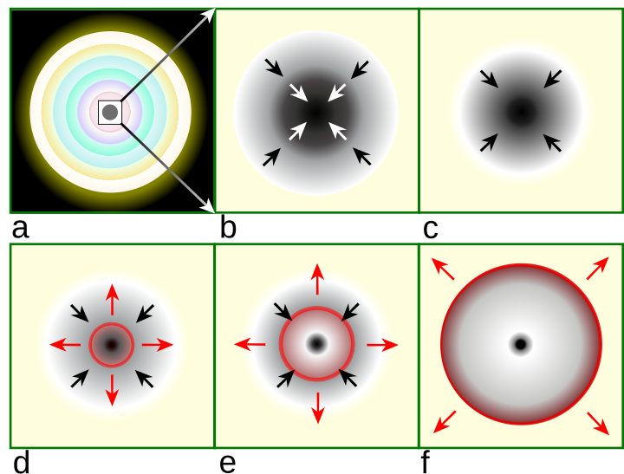
Supernova explosion – 1. Core – Collapse Supernova explosion
Masses > 8 solar mass
Electron degeneracy pressure not
Sufficient, then iron core starts to collapse
p+e → n + neutrino
Neutron gives pressure to support inward
Pull
Supernova explosion and heavy element formation
Energy release is so fast
Neutron star or black hole

Slide 8
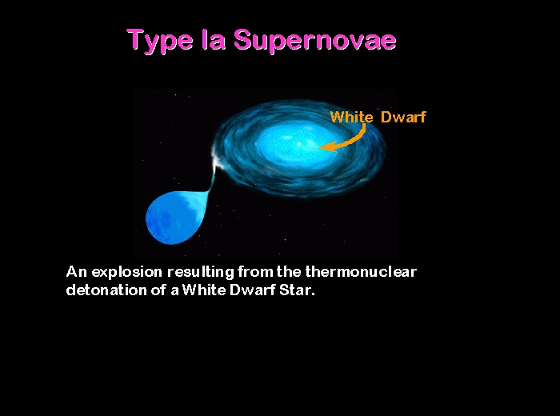
2.Thermonuclear Supernova explosion
White dwarf with binary
Companion (red giant)
Mass < 8 solar mass
Mostly carbon and oxygen
Start to pull mass from it companion
Temperature rise and thermal runaway
Leaves no remnant

Slide 9
The core mass after supernova M
Red giant becomes White dwarf (M<1.4 Mass of the sun)
Super red giant becomes Neutron star (1.4 <M<8 Mass of the sun)
What will happen if mass is greater than 8 times mass of the sun?

Slide 10
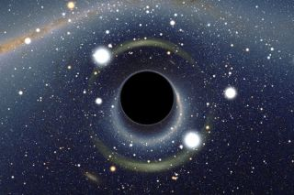
Black hole
Strongest gravity place
Light cannot escape
Singularity
Event horizon
Space – time curved much

Slide 11
John Mitchell – 1783 – (Newton theory)
General theory of relativity – Solution of Field equation
1968 – John Wheeler coined the term “black hole”
Before that, it was called “Schwarzschild singularities”

Slide 12
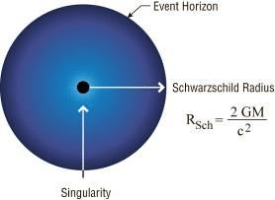
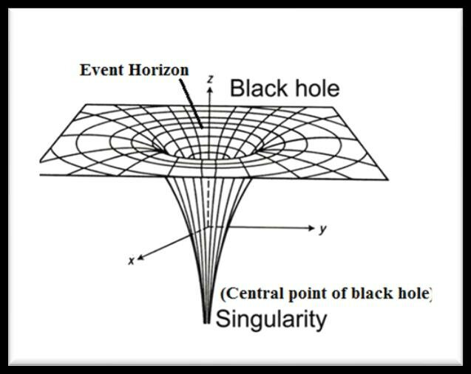

Slide 13
Two types of classification
1. Schwarzschild blackhole – Only mass, no spin, no charge
2. Reissner – Nordstorm blackhole – mass and charge but no spin black hole – Mass and Charge, no spin
3. Kerr-Black hole – Mass, spin but no charge

Slide 14
Classification based on observation
Stellar black holes (3 M to 100 M)
Intermediate black holes (100 M to 100000M)
Super massive black holes (million to billion times of the mass of the sun)

Slide 15
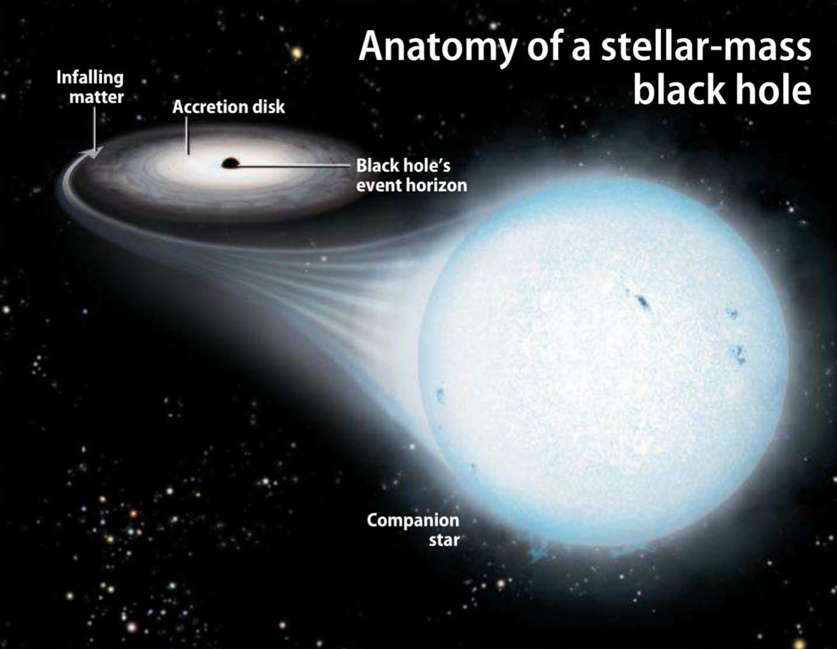
Stellar black hole
Mostly from binary star
Cygnus X-1 (1965)

Slide 16
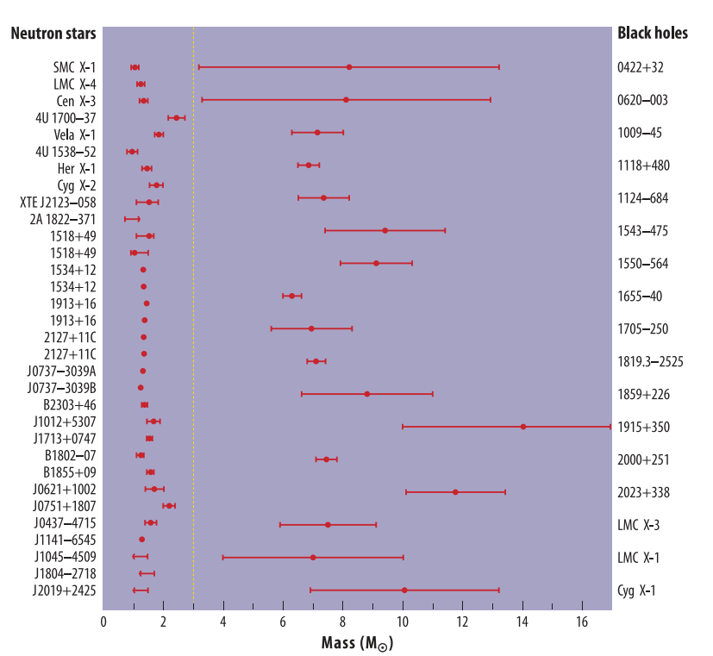

Slide 17
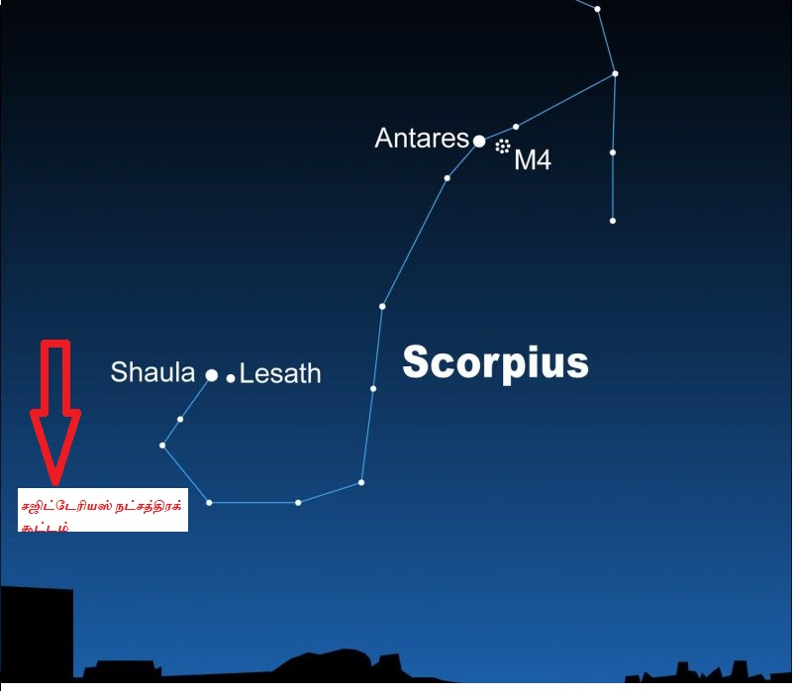
Super massive black holes
Center of almost all galaxies
Messier galaxy M87*
Milky way galaxy Sagittarius A*

Slide 18
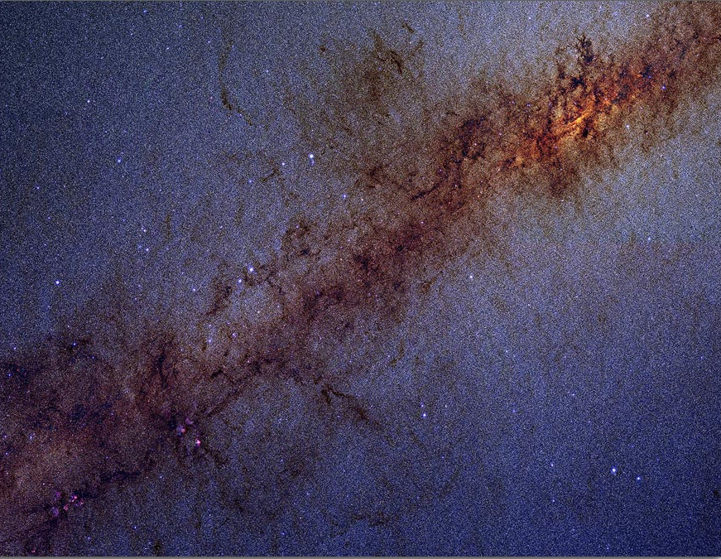
How have we survived?
There are 200 billion stars in our galaxy, the Milky Way
There are also millions of black holes
Including one giant black hole at the very center.
How do have we survived?

Slide 19
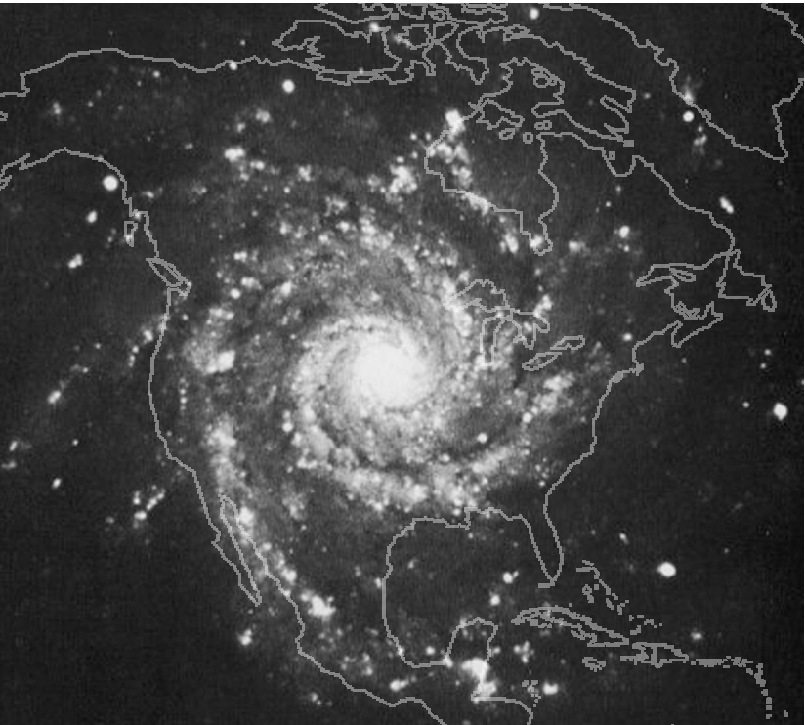
So how do we survive amid all these Black Holes?
M74 Photo Credit: NOAO/AURA/NSF
Great distances between the stars!
Notes:
Credit: M74 Photo Credit: NOAO/AURA/NSF

Slide 20

What do you think?
What happens to a spaceship that falls into a black hole?
Will the black holes in our Galaxy eventually suck up everything in it - a cosmic vacuum cleaner?
What would happen to Earth if the Sun was replaced by a black hole of the same mass?
If we can’t see black holes, how do we know they are there?

Slide 21

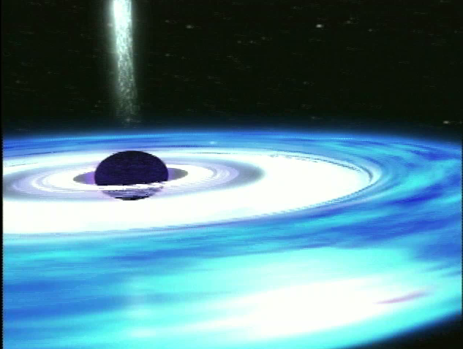
Falling into a Black Hole
Not to Scale

Slide 22
Falling into a Black Hole
Not to Scale

Slide 23
Falling into a Black Hole
Not to Scale

Slide 24
Falling into a Black Hole
Not to Scale

Slide 25
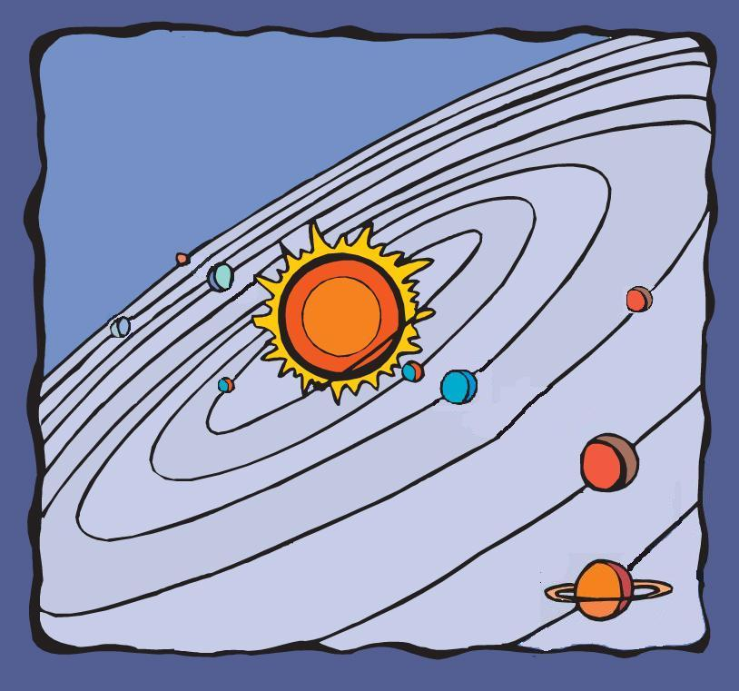
What would happen if the Sun was…
Not to Scale

Slide 26
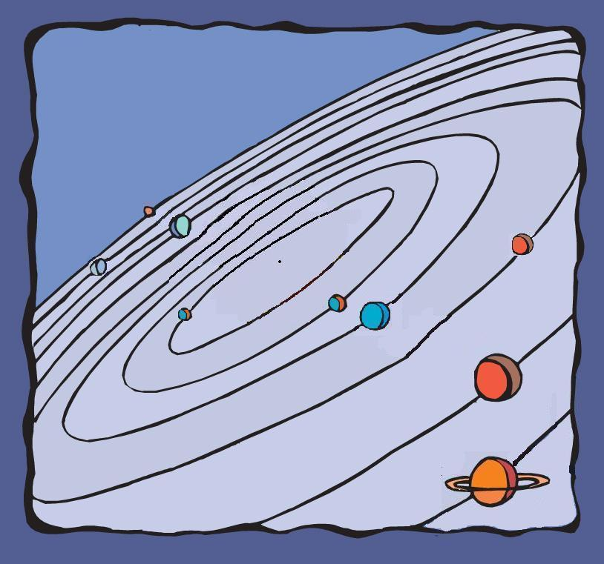
… changed into a Black Hole?
Not to Scale

Slide 27
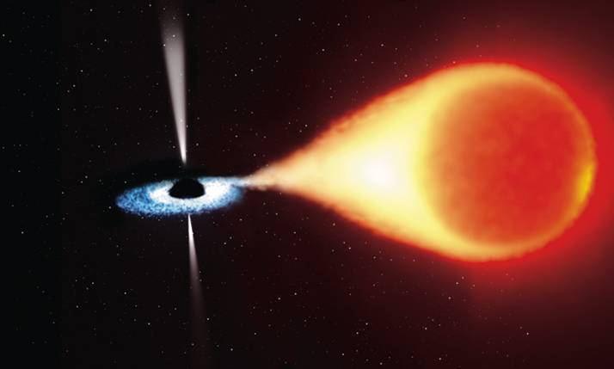
How do we know it’s there?
Jets of glowing gas
“Weird” motions of objects nearby
Hot material falling into the black hole.
Credit: ESA, NASA, and Felix Mirabel
Notes:
(An artist’s impression of an X-Ray binary system, the best way to detect a black hole. )
ANIMATION: http://nova.scitec.kobe-u.ac.jp/~matsuda/mpeg/accretion.mpg

Slide 28
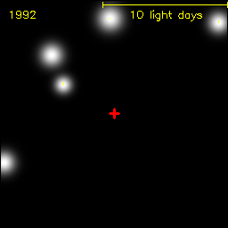
How do we know it’s there?
Years
“Weird” motions of objects nearby
Movie courtesy Max-Planck-Institute for extraterrestrial Physics, Germany.
Notes:
© Infrared and Submillimeter Astronomy Group at MPE
(Max-Planck-Institut für extraterrestrische Physik)

Slide 29
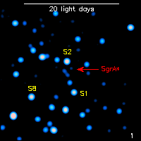
How do we know it’s there?
Hot material falling into the black hole.
Minutes
Movie courtesy Max-Planck-Institute for extraterrestrial Physics, Germany.
Notes:
© Infrared and Submillimeter Astronomy Group at MPE
(Max-Planck-Institut für extraterrestrische Physik)
NOTE: This is an infrared image rather than an X-Ray image, but the effect would be essentially the same.

Slide 30

2020 Physics Noble Prize

Slide 31
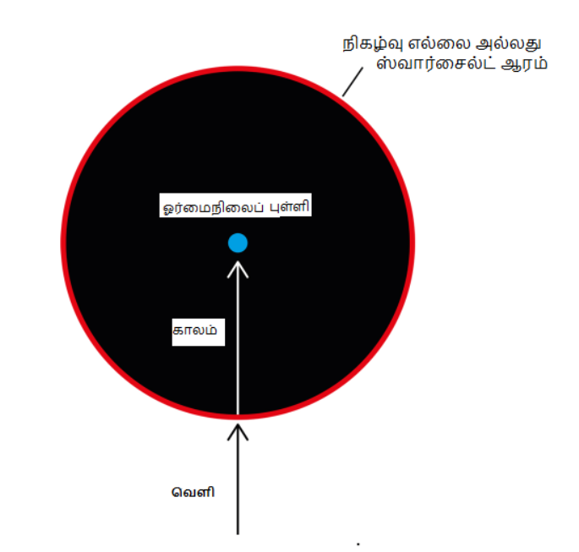
கருந்துளைக்குள் இருப்பது வெறும் காலம் மட்டுமே.

Slide 32
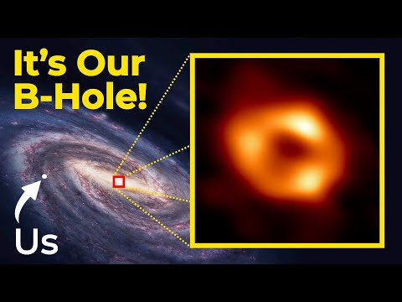
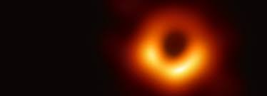
M87* and Sag A*

Slide 33
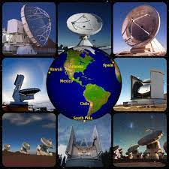
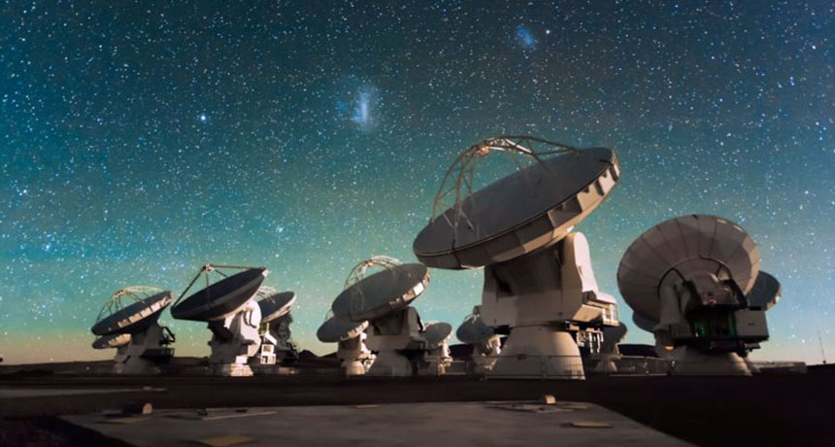
Event Horizon telescopes

Slide 34
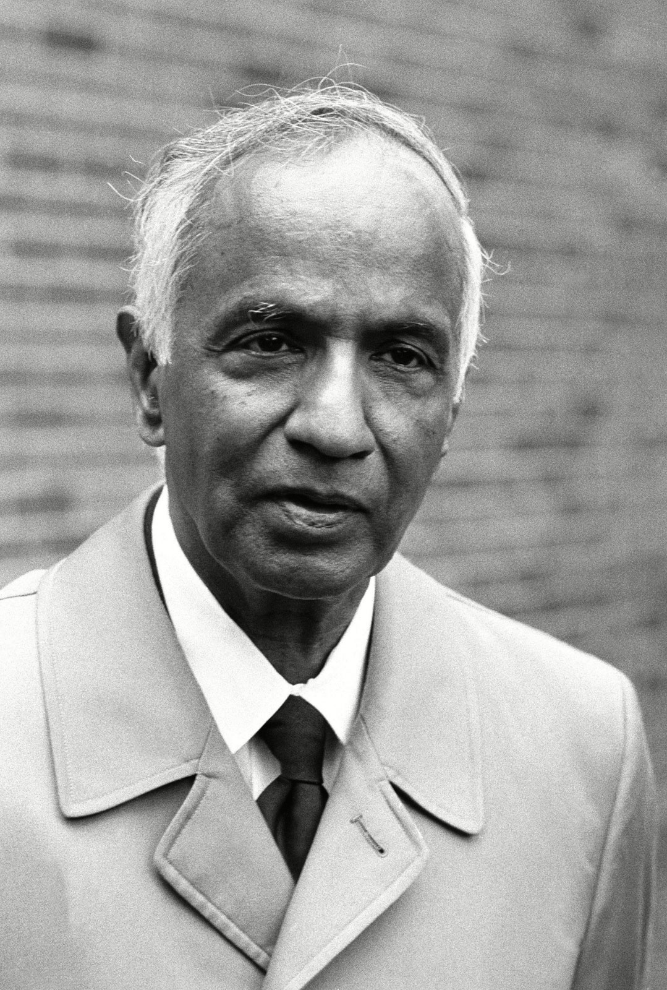
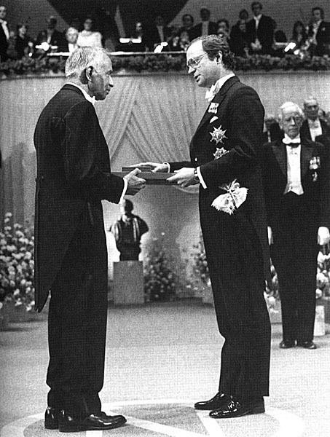

Slide 35
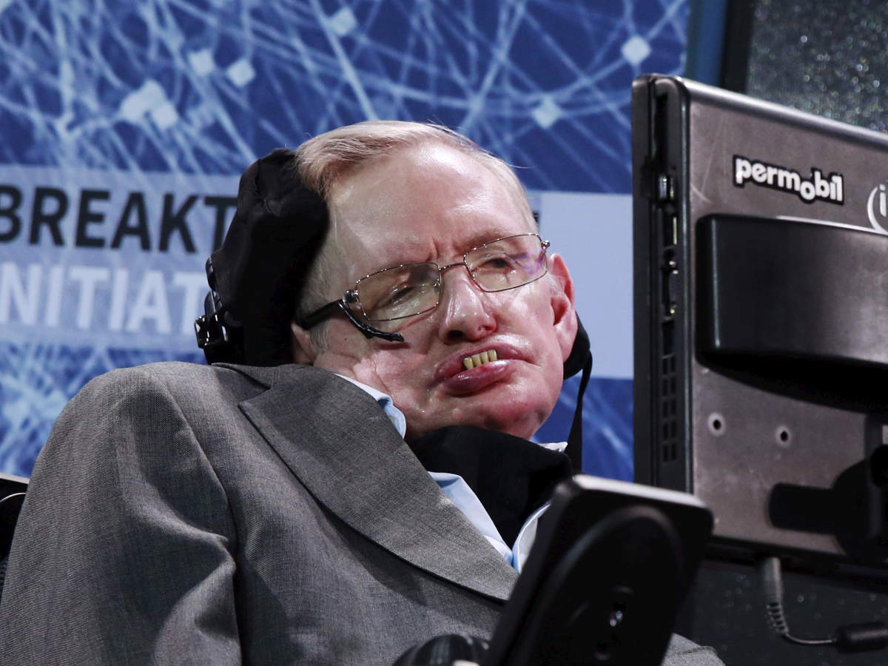
Stephen Hawking - Black hole

Slide 36
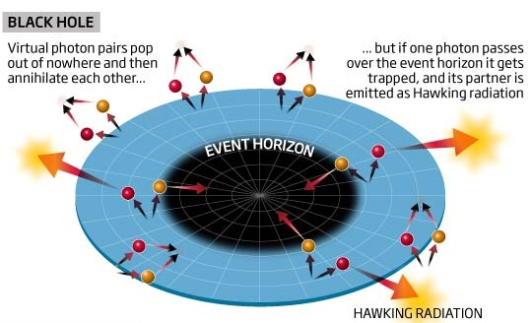
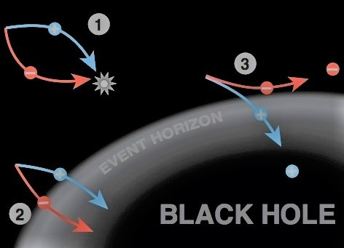
Hawking radiation
General relativity + Quantum mechanics

Slide 37
Hawking radiation – no observable evidence so far
The energy of radiation is inversely proportional to its mass
Slowly the blackhole evaporate (prediction!!!!)

Slide 38
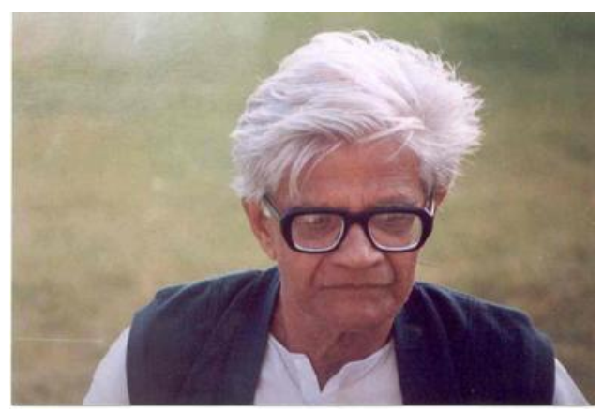
அமல் ரே சவுத்ரி

Slide 39
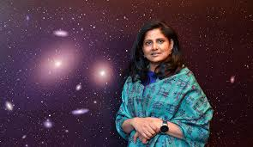
Priyamvada Natarajan – Yale University
She born in Coiambatore, Tamilnadu

Slide 40
Thank you all !!!!

